Slide 1
Multicultural Education Dr. Melissa Reed Teacher Residency Boot Camp July 2020

Slide 2
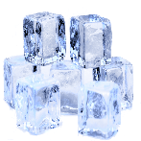
STAND-UP
Notes:
People Diversity Bingo – reimagined
Look at your peers as you do this activity – what are your similarities and differences

Slide 3
What is privilege?
Notes:
https://youtu.be/4K5fbQ1-zps

Slide 4
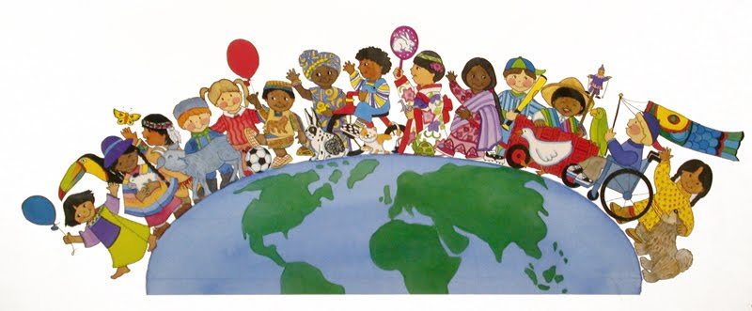
What is Diversity in Education? Think – Pair - Share
Notes:
Think-pair-share – what is diversity in education or urban education?
Here is a short video that gives you a glimpse into diversity in education and the different aspects that make you and your students unique!
https://youtu.be/CqV3CK6QfcU
Not sure - https://youtu.be/bFMcbOwCCYE

Slide 5
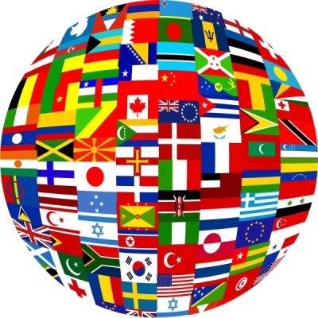
NATIONALITY:
The status of belonging to a particular nation, whether by birth or naturalization.
Notes:
https://youtu.be/CqV3CK6QfcU

Slide 6
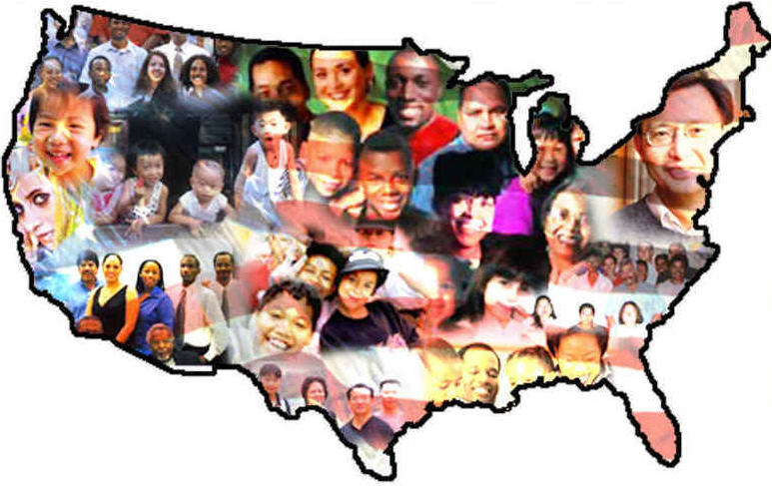
ETHNICITY:
Relating to or characteristic of a human group having racial, religious, linguistic, and certain other traits in common.
Notes:
Ethnicity, however, refers to cultural factors, including nationality, regional culture, ancestry, and language. ... You can have more than one ethnicity but you are said to have one race, even if it's "mixed race". Examples of ethnicity include being Indian, Jewish or Asian, regardless of race. So a female born to Japanese parents in Atlanta might consider herself as racially Asian, but as ethnically Japanese, American, Japanese-American or even just American
Ethnicity is considered an anthropological term because it is based on learned behaviors, not biological factors. Many people have mixed cultural backgrounds and can share in more than one ethnicity.

Slide 7
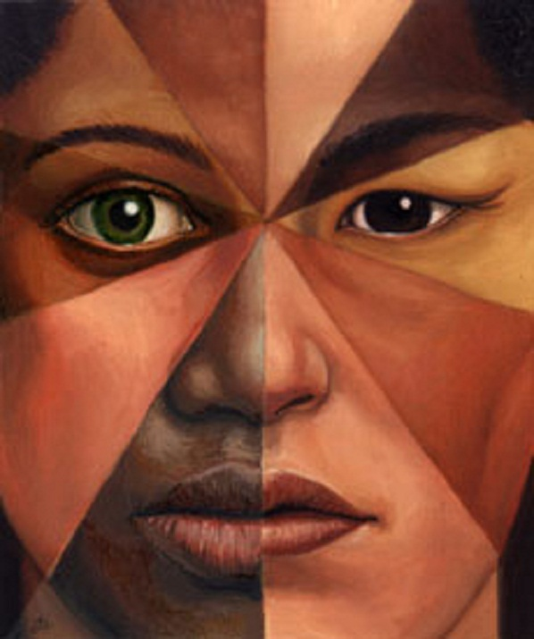
RACE:
A group of persons related by common descent or heredity. An arbitrary classification of modern humans, based on any or a combination of various physical characteristics, as skin color, facial form, or eye shape.
Notes:
Race refers to a person's physical characteristics, such as bone structure and skin, hair, or eye color.
http://www.pbs.org/race/000_General/000_00-Home.htm
Great Website – Use Ipads for activity

Slide 8
CIRCLES OF MY MULTICULTURAL SELF
Educator
Female
Dr. Reed
Catholic
East Coast
Notes:
This activity highlights the multiple dimensions of our identities. It addresses the importance of individuals self-defining their identities and challenging stereotypes.
Discuss in small groups

Slide 9
CIRCLES OF MY MULTICULTURAL SELF
Share a story about a time you were especially proud to identify yourself with one of the descriptors you used above.
Share a story about a time it was especially painful to be identified with one of your identifiers or descriptors.
Name a stereotype associated with one or more of the groups with which you identify that is not consistent with who you are.
Fill in the following sentence:
I am (a/an) _________ but I am NOT (a/an)_____________.
(Ex. I am a FEMALE but I am NOT a bad driver.)

Slide 10
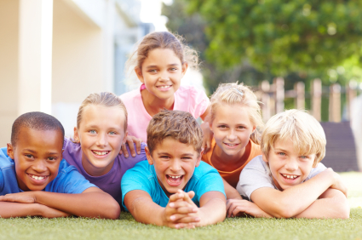
DIVERSITY
Notes:
VIDEO EMBEDDED – Children and diversity. Perspective on self and race, ethnicity through the eyes of children.

Slide 11
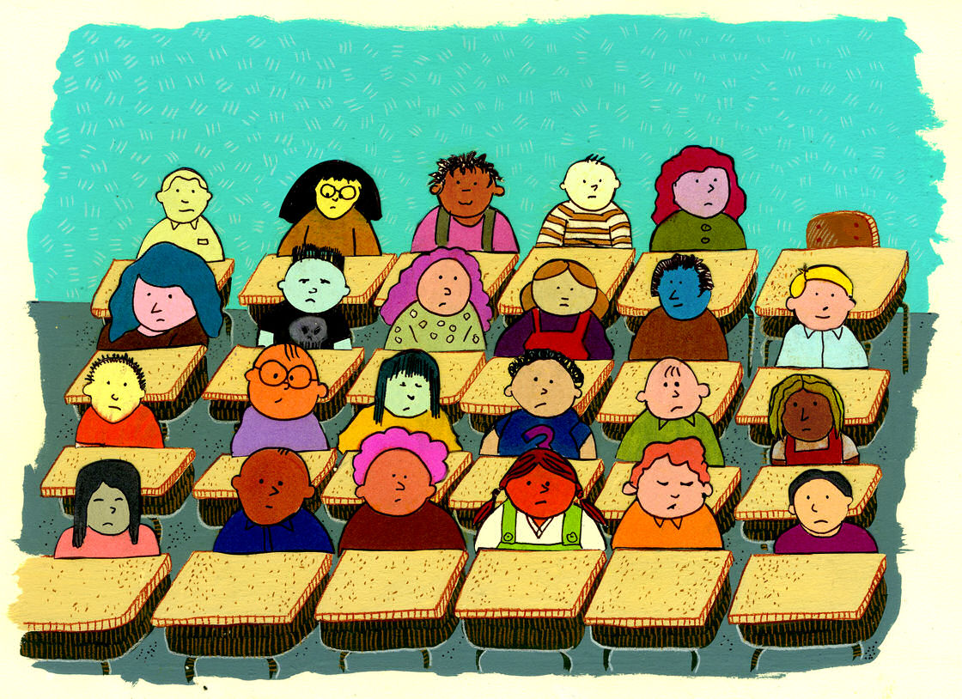
Notes:
https://youtu.be/oy35vmFuCk8
Ideas to be used in the classroom.

