Slide 1
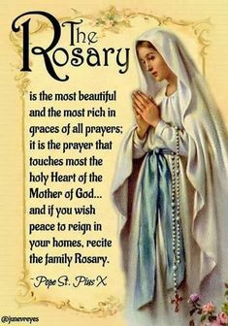
In the Name of the Father, and of the Son and of the Holy Spirit Amen.

Slide 2
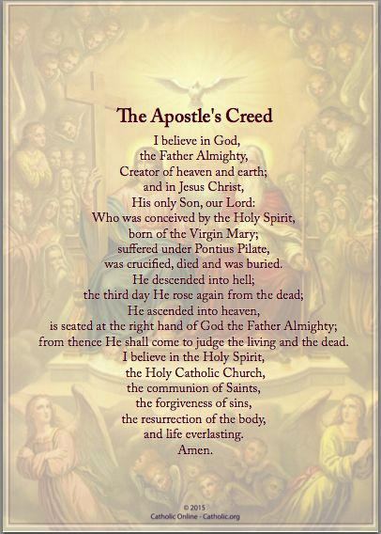

Slide 3
Our Father.
Who art in heaven,
Hallowed be Thy Name.
Thy kingdom come.
Thy will be done on earth as it is in heaven
Give us this day our daily bread and
Forgive us our trespasses as we forgive those who trespass against us.
Lead us not into temptation but deliver us from evil. Amen.

Slide 4
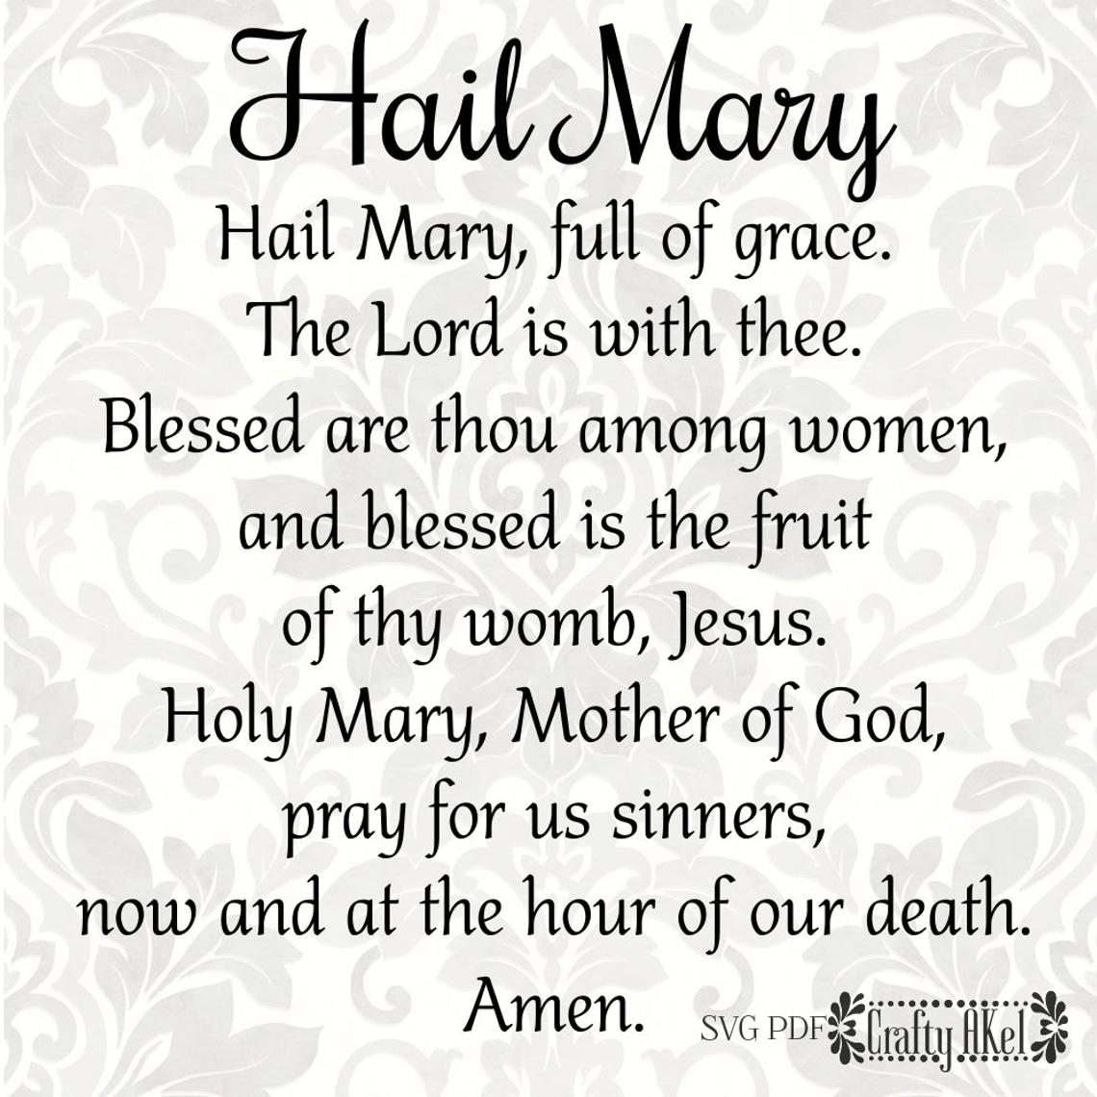

Slide 7
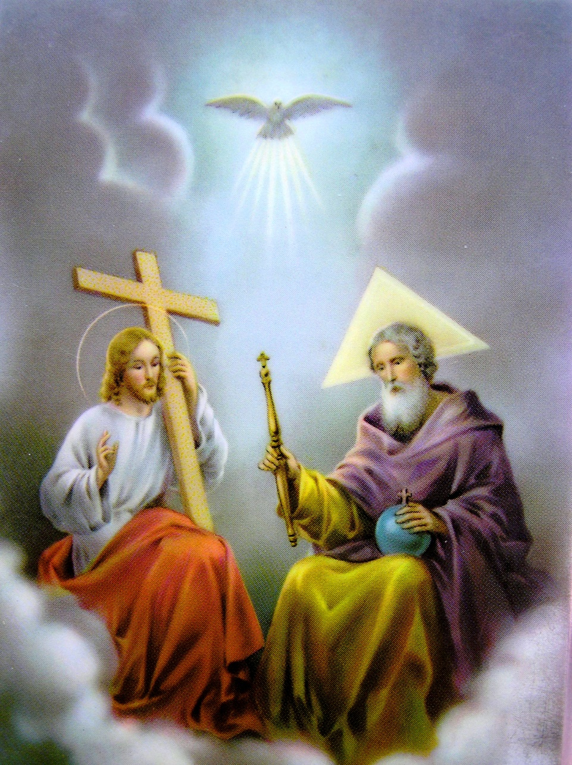
Glory Be to the Father
and to the Son
and to the Holy Spirit
as it was in the beginning, is now,
and ever shall be
world without end. Amen.

Slide 8
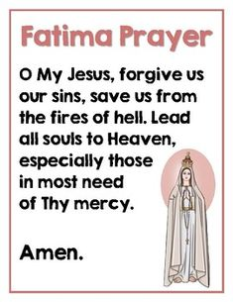
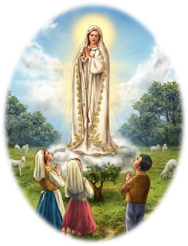

Slide 9
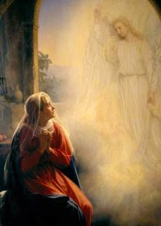
"The Holy Spirit shall come upon you and the power of the Most High shall overshadow you.“ “And therefore the Holy One to be born shall be called the Son of God." (Luke 1:35) "Behold the handmaid of the Lord: be it done to me according to your word." (Luke 1:38)
1st Joyful Mystery – The Annunciation
The first Joyful mystery reminds us that messengers of God come to us in daily circumstances and opportunities just as Gabriel came to Mary. I need only pay attention. Mary said “Yes” to God without knowing the whole picture – what will happen and how it all will end. Let us pray during this mystery that we will listen to God’s messengers and pray that we, like Mary, will trust that His plan is what is best for us at this time.

Slide 10
Our Father.
Who art in heaven,
Hallowed be Thy Name.
Thy kingdom come.
Thy will be done on earth as it is in heaven
Give us this day our daily bread and
Forgive us our trespasses as we forgive those who trespass against us.
Lead us not into temptation but deliver us from evil. Amen.

Slide 11
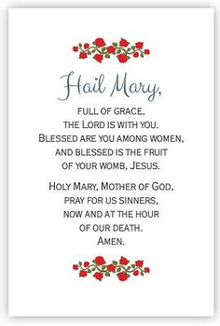

Slide 21
Glory Be to the Father
and to the Son
and to the Holy Spirit
as it was in the beginning, is now,
and ever shall be
world without end. Amen.

Slide 23
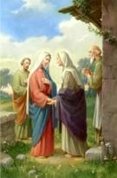
2nd Joyful Mystery – The Visitation
Mary said: “My soul proclaims the greatness of the Lord; my spirit rejoices in God my savior. For he has looked upon his handmaid’s lowliness; behold, from now on will all ages call me blessed.” Luke 1:48)
This mystery reminds us that like Elizabeth, we should be eager to recognize Christ in others. Like Mary, we should bring Jesus into the lives and homes of others.
Mary’s first Christian responsibility was doing household chores. Like Mary, our Christian life means doing small things with love.
Let us pray for the grace to be a messenger of God’s love to others and to do the small things we do each day with love.

Slide 24
Our Father.
Who art in heaven,
Hallowed be Thy Name.
Thy kingdom come.
Thy will be done on earth as it is in heaven
Give us this day our daily bread and
Forgive us our trespasses as we forgive those who trespass against us.
Lead us not into temptation but deliver us from evil. Amen.

Slide 35
Glory Be to the Father
and to the Son
and to the Holy Spirit
as it was in the beginning, is now,
and ever shall be
world without end. Amen.

Slide 37
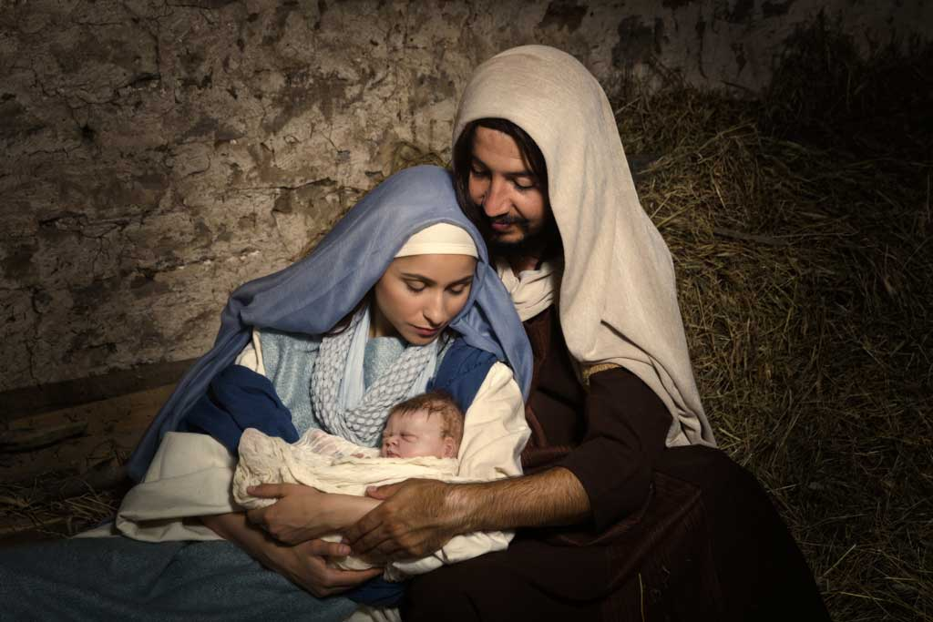
3rd Joyful Mystery – The Birth of Jesus
The angel said to them, “Do not be afraid; for behold, I proclaim to you good news of great joy that will be for all the people. For today in the city of David a savior has been born for you who is Messiah and Lord. And this will be a sign for you: you will find an infant wrapped in swaddling cloth es and lying in a manger.” Luke 2: 9
This mystery reminds us that we can count on God’s answers to our prayers, but often in unexpected ways – a stable instead of a room. The Wise Men read the books, learned where to find Christ, and traveled for days to meet him. Do we travel as far as the Church to find him in the tabernacle.
During this mystery, let us pray that like the Wise Men, we will give our best to God --our best time, our best efforts, our best talents? Let us pray for the gift of faith to believe that God does hear and answer our prayers.

Slide 38
Our Father.
Who art in heaven,
Hallowed be Thy Name.
Thy kingdom come.
Thy will be done on earth as it is in heaven
Give us this day our daily bread and
Forgive us our trespasses as we forgive those who trespass against us.
Lead us not into temptation but deliver us from evil. Amen.

Slide 49
Glory Be to the Father
and to the Son
and to the Holy Spirit
as it was in the beginning, is now,
and ever shall be
world without end. Amen.

Slide 50
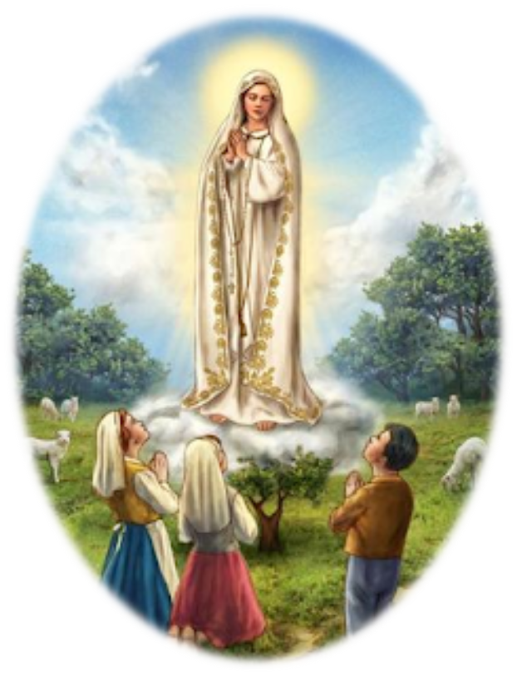

Slide 51
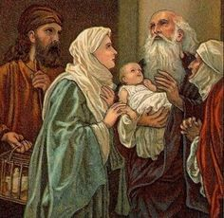
4th Joyful Mystery - The Presentation
According to the Law of Moses, they took Jesus up to Jerusalem to present Him to the Lord. (Luke 2:32)
Mary and Joseph showed their great respect for God’s law and, despite the difficulties in traveling to Jerusalem to present Jesus in the temple they did so. During this mystery we pray that we, too, show respect and obedience to the law (both God’s law and civil law) even when it is difficult.

Slide 52
Our Father.
Who art in heaven,
Hallowed be Thy Name.
Thy kingdom come.
Thy will be done on earth as it is in heaven
Give us this day our daily bread and
Forgive us our trespasses as we forgive those who trespass against us.
Lead us not into temptation but deliver us from evil. Amen.

Slide 63
Glory Be to the Father
and to the Son
and to the Holy Spirit
as it was in the beginning, is now,
and ever shall be
world without end. Amen.

Slide 65
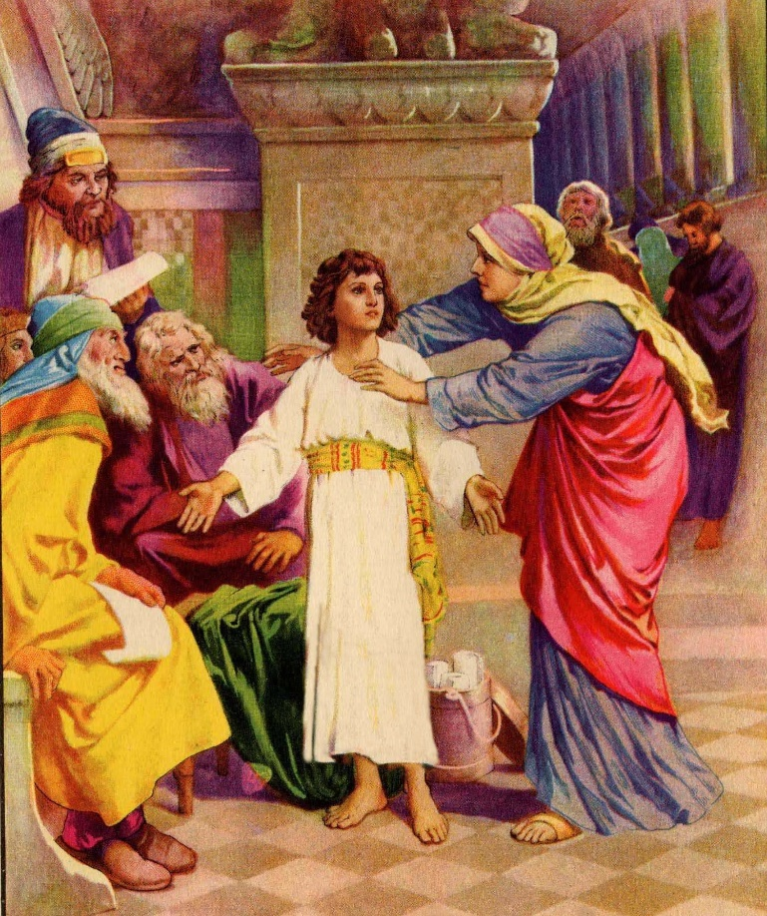
5th Joyful Mystery – Finding Jesus in the Temple
They returned to Jerusalem in search of Him. And after three days, they found Him in the temple. (Luke 2:45-46)
When we meditate on this Joyful Mystery, what comes to mind is the loss that Mary and Joseph must have felt when they could not find Jesus and the joy they experienced when, after a long search, they found Him. During this mystery we pray that we will persevere in our efforts to find Jesus in our lives We pray, too, that, like Jesus, we will grow in wisdom, grace and faith as we show respect for our parents, teachers and all who care for us.

Slide 66
Our Father.
Who art in heaven,
Hallowed be Thy Name.
Thy kingdom come.
Thy will be done on earth as it is in heaven
Give us this day our daily bread and
Forgive us our trespasses as we forgive those who trespass against us.
Lead us not into temptation but deliver us from evil. Amen.

Slide 77
Glory Be to the Father
and to the Son
and to the Holy Spirit
as it was in the beginning, is now,
and ever shall be
world without end. Amen.

Slide 79
O God, whose only-begotten Son, by His life, death and resurrection, has purchased for us the rewards of eternal life; grant, we beseech Thee, that, while meditating upon these mysteries of the Most Holy Rosary of the Blessed Virgin Mary, we may imitate what they contain and obtain what they promise, through Christ Our Lord. Amen.

Slide 80
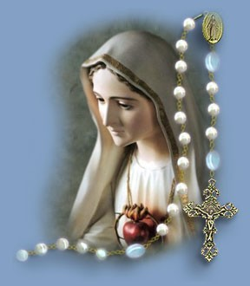
Let us conclude our prayers with the prayers recommended to us by Pope Francis.

Slide 81
Let Us Pray
O Mary, You shine continuously on our journey as a sign of salvation and hope. We entrust ourselves to you, Health of the Sick, who, at the foot of the cross, were united with Jesus’ suffering, and persevered in your faith.“Protectress of all people”, you know our needs, and we know that you will provide, so that, as at Cana in Galilee, joy and celebration may return after this time of trial.
Help us, Mother of Divine Love, to conform ourselves to the will of the Father and to do what Jesus tells us. For he took upon himself our suffering, and burdened himself with our sorrows to bring us, through the cross, to the joy of the Resurrection. Amen.
We fly to your protection, O Holy Mother of God; Do not despise our petitions in our necessities, but deliver us always from every danger, O Glorious and Blessed Virgin.

Slide 82
Response: “We fly to your protection, O Holy Mother of God”.
In the present tragic situation, when the whole world is prey to suffering and anxiety, we fly to you, Mother of God and our Mother, and seek refuge under your protection.
Virgin Mary, turn your merciful eyes towards us amid this coronavirus pandemic. Comfort those who are distraught and mourn their loved ones who have died, and at times are buried in a way that grieves them deeply. Be close to those who are concerned for their loved ones who are sick and who, in order to prevent the spread of the disease, cannot be close to them. Fill with hope those who are troubled by the uncertainty of the future and the consequences for the economy and employment.
Mother of God and our Mother, pray for us to God, the Father of mercies, that this great suffering may end and that hope and peace may dawn anew. Plead with your divine Son, as you did at Cana, so that the families of the sick and the victims be comforted, and their hearts be opened to confidence and trust.
Protect those doctors, nurses, health workers and volunteers who are on the frontline of this emergency, and are risking their lives to save others. Support their heroic effort and grant them strength, generosity and continued health.
Be close to those who assist the sick night and day, and to priests who, in their pastoral concern and fidelity to the Gospel, are trying to help and support everyone.

Slide 83
Blessed Virgin, illumine the minds of men and women engaged in scientific research, that they may find effective solutions to overcome this virus.
Support national leaders, that with wisdom, solicitude and generosity they may come to the aid of those lacking the basic necessities of life and may devise social and economic solutions inspired by farsightedness and solidarity.
Mary Most Holy, stir our consciences, so that the enormous funds invested in developing and stockpiling arms will instead be spent on promoting effective research on how to prevent similar tragedies from occurring in the future.
Beloved Mother, help us realize that we are all members of one great family and to recognize the bond that unites us, so that, in a spirit of fraternity and solidarity, we can help to alleviate countless situations of poverty and need. Make us strong in faith, persevering in service, constant in prayer.
Mary, Consolation of the afflicted, embrace all your children in distress and pray that God will stretch out his all-powerful hand and free us from this terrible pandemic, so that life can serenely resume its normal course.
To you, who shine on our journey as a sign of salvation and hope, do we entrust ourselves,
O Clement, O Loving, O Sweet Virgin Mary. Amen.

Slide 84
