Slide 1
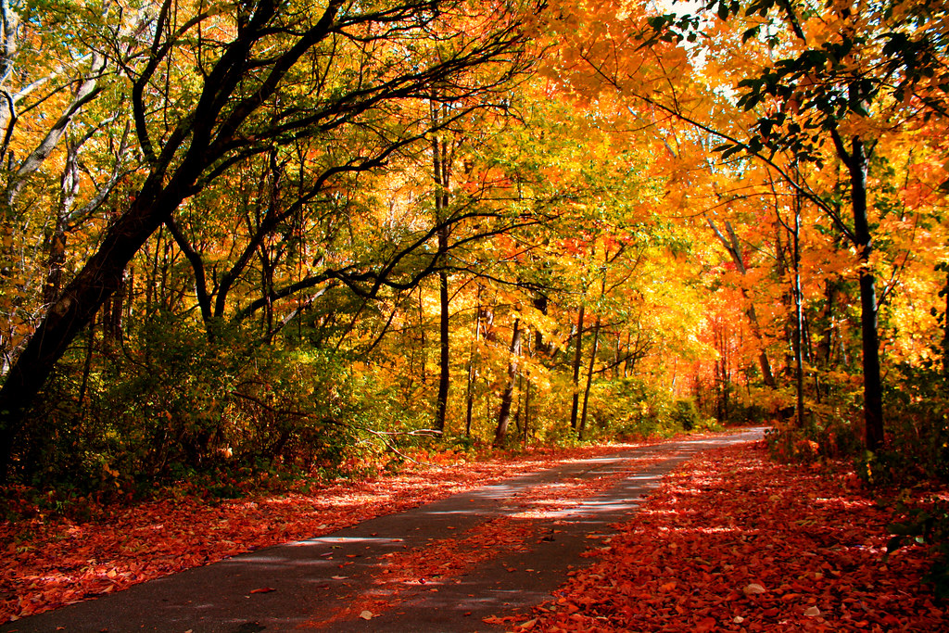
Give Thanks to the Lord
For
He is Good

Slide 2
Before We Begin. . .
Think about the things that you are thankful for and begin to raise you voice to heaven in gratitude to the Lord for those things. The heart of a worshipper understands that worship is as much to God as it is to the worshipper. It is an audible reminder of who God is, at a time when you desperately need to hear it.

Slide 3
Lord I thank you for:
As we think about those things for which we are grateful, we will pause with each slide so that you can form your own prayer of Thanksgiving. To get ready, do the following:
Take a blank piece of paper. Fold it in half lengthwise (like a hot dog roll. Make a good crease in the paper.
Open it up and fold it in half widthwise (like a hamburger roll.)
Fold it in half again; then open the last fold and, beginning with the closed side, rip/cut on the crease to the middle fold. You should wind up with a hole in the middle of the paper.
Fold the paper again to the original “hot dog” fold. Push the two ends together and you will have created a little booklet.
On the front of the booklet, write:

Slide 4
Now, let us think about the things for which we are grateful.
We will pause at the end of each slide.At that time write a sentence/draw a picture to add to your Thanksgiving Prayer Book.

Slide 5
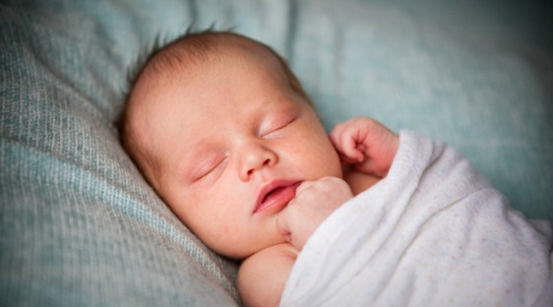
Life
Think of life and all that it means. To be able to breathe, to see, to be seen, to hear and to be heard. God has us covered. Not a feather will fall off a sparrow without Him noticing. He knows you. He sees all that is going on around you and is in control.

Slide 6
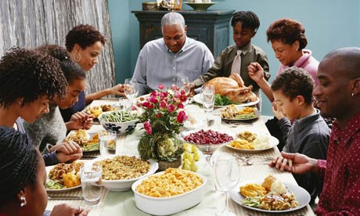
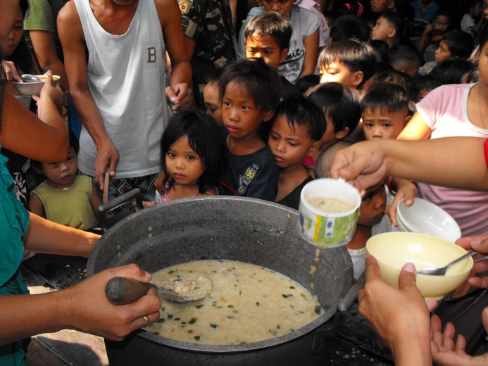
Food
With so many who are hungry in many parts of the world, we ought to be grateful for every meal that we get.

Slide 7
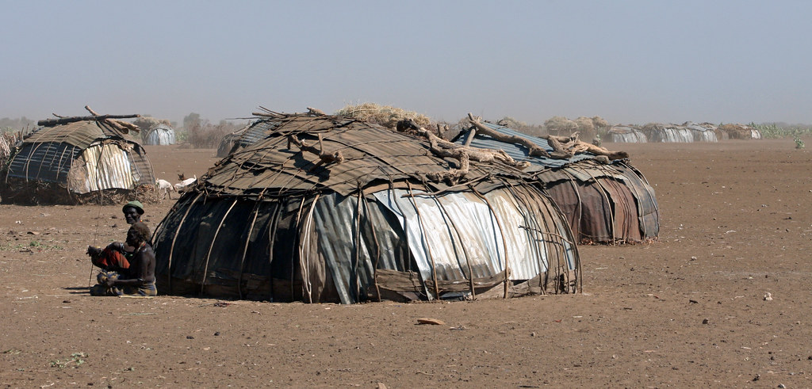
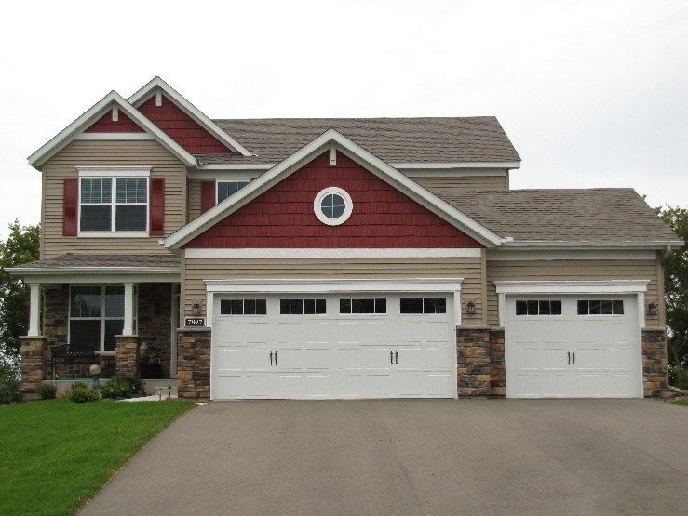
Shelter
For a place to call home, a place to lay our head, gratitude is owed.

Slide 8
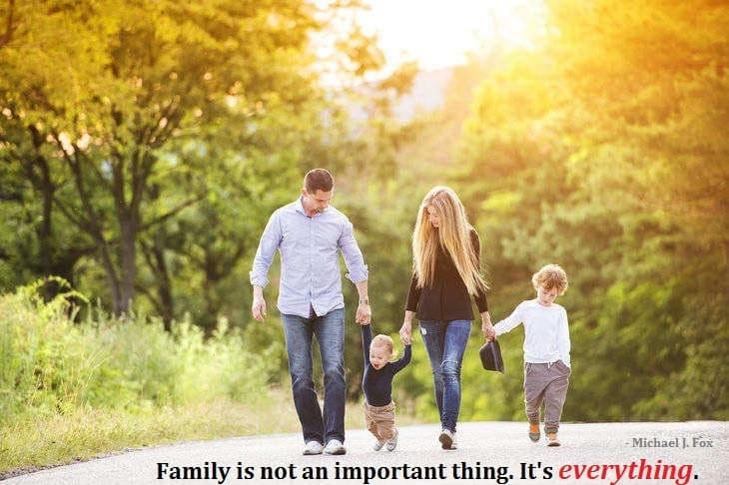
Family
They may not be perfect, but they are ours to keep. This is the one gift God gave us without a choice. Thank you Lord for whatever reason you had for that. You don’t owe me an explanation, I trust in you.

Slide 9
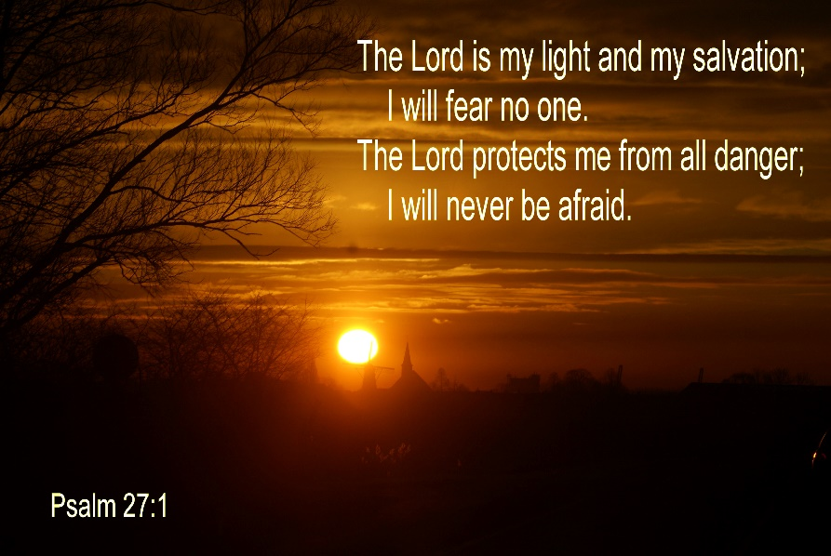
Hope
Father in heaven, through You we can look forward to tomorrow. We have hope for what can be. We are eternally grateful.

Slide 10
Direction
Lord we are grateful for directing us at all turns. We don’t always listen, yet you always speak.

Slide 11
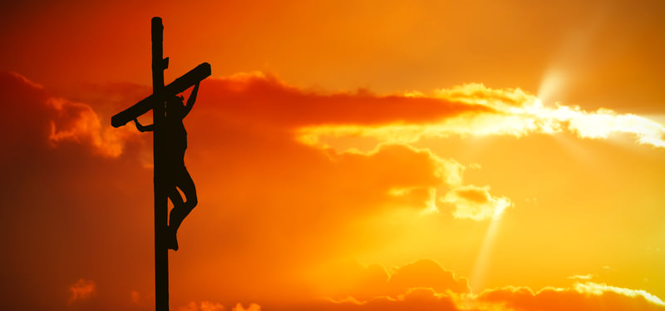
Salvation
For the greatest of all gifts--Sending your Son to give His Life for what we ought to have made up for. Thank you for saving us.

Slide 12
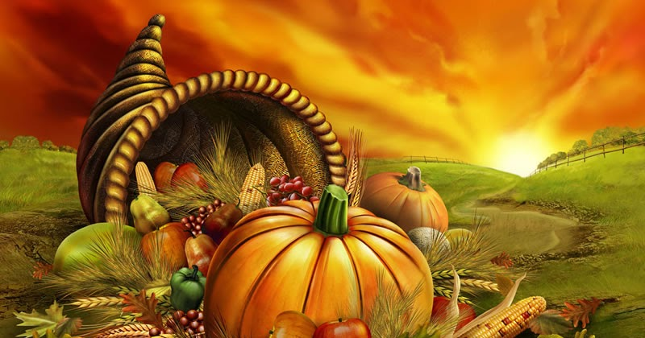
Prayer of Thanksgiving

Slide 13
God of all blessings, source of all life, giver of all grace:

Slide 14
We thank you for the gift of life: for the breath that sustains life, for the food of this earth that nurtures life, for the love of family and friends without which there would be no life.

Slide 15
We thank you
for the mystery of creation: for the beauty that the eye can see, for the joy that the ear may hear, for the unknown that we cannot behold filling the universe with wonder, for the expanse of space that draws us beyond the definitions of our selves.

Slide 16
We thank You
for setting us in communities: for families,
who nurture our becoming, for friends,
who love us by choice, for companions at school and work, who share our burdens and daily tasks,

Slide 17
for strangers,
who welcome us into their midst, for people from other lands who call us to grow in understanding, for children,
who lighten our moments with delight, for the unborn,
who offer us hope for the future.

Slide 18
We thank you for this day: for life, and one more day to love, for opportunity and one more day to work for justice and peace, for neighbors,
and one more person to love and by whom be loved, for your grace, and one more experience of your presence, for your promise: to be with us, to be our God,and to give salvation.

Slide 19
For these,
and all blessings, we give you thanks,
eternal, loving God, through Jesus Christ we pray. Amen.

