Slide 1
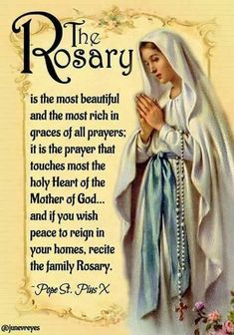
In the Name of the Father, and of the Son and of the Holy Spirit Amen.

Slide 2
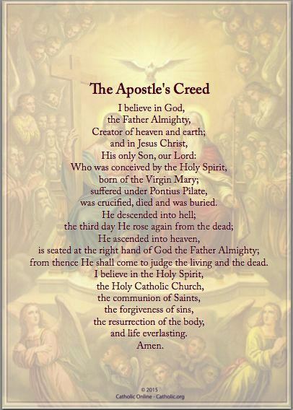

Slide 3
Our Father.
Who art in heaven,
Hallowed be Thy Name.
Thy kingdom come.
Thy will be done on earth as it is in heaven
Give us this day our daily bread and
Forgive us our trespasses as we forgive those who trespass against us.
Lead us not into temptation but deliver us from evil. Amen.

Slide 4
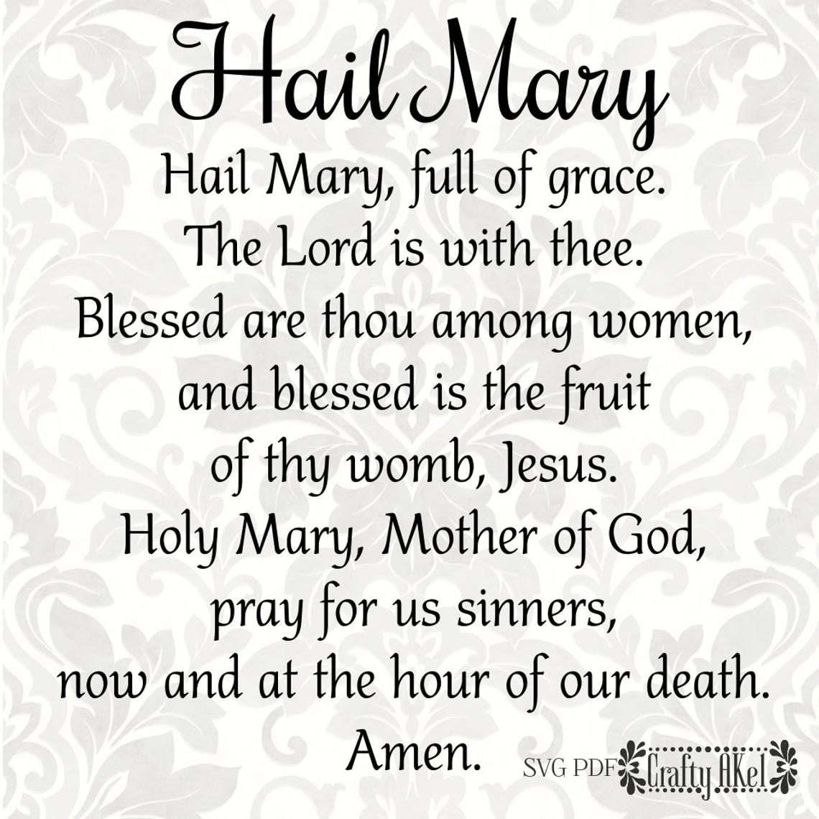

Slide 7
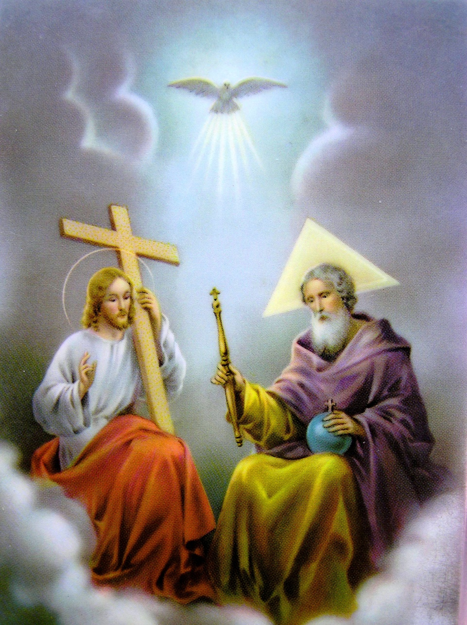
Glory Be to the Father
and to the Son
and to the Holy Spirit
as it was in the beginning, is now,
and ever shall be
world without end. Amen.

Slide 8
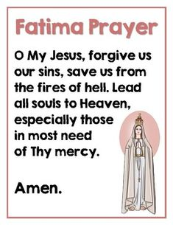
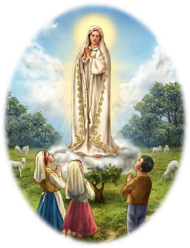

Slide 9
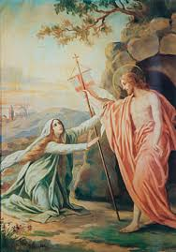
1st Glorious Mystery – The Resurrection
You need not be amazed! You are looking for Jesus of Nazareth, the one who was crucified. He has been raised up; He is not here. See the place where they had laid Him. Mark 16:6
This Glorious Mystery is the cornerstone of the Christian faith. On this, we meditate Jesus’ conquering of death by rising again. During this mystery, we ask Mary’s intercession that the peoples of the world may rise again from the pandemic which plagues us at the present time.

Slide 10
Our Father.
Who art in heaven,
Hallowed be Thy Name.
Thy kingdom come.
Thy will be done on earth as it is in heaven
Give us this day our daily bread and
Forgive us our trespasses as we forgive those who trespass against us.
Lead us not into temptation but deliver us from evil. Amen.

Slide 11
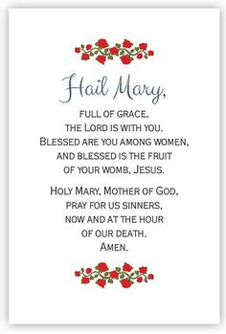

Slide 21
Glory Be to the Father
and to the Son
and to the Holy Spirit
as it was in the beginning, is now,
and ever shall be
world without end. Amen.

Slide 23
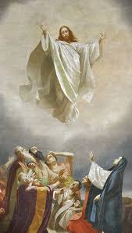
2nd Glorious Mystery – The Ascension
Then, after speaking to them, the Lord Jesus was taken up into Heaven and took His seat at God’s right hand. Mark 16:19
It was time for Jesus to return to His father in Heaven. Before He did this, the last thing He gave to his Apostles was the Great Commission. He commanded that they go forth and bring as many people to him as possible. During this mystery we ask Mary to intercede for us to the Father that we may have the courage to set an example of faith to bring others to God and that our society will “ascend” from acts of rioting and violence to acts of peace and faith.

Slide 24
Our Father.
Who art in heaven,
Hallowed be Thy Name.
Thy kingdom come.
Thy will be done on earth as it is in heaven
Give us this day our daily bread and
Forgive us our trespasses as we forgive those who trespass against us.
Lead us not into temptation but deliver us from evil. Amen.

Slide 35
Glory Be to the Father
and to the Son
and to the Holy Spirit
as it was in the beginning, is now,
and ever shall be
world without end. Amen.

Slide 37
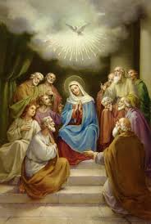
3rd Glorious Mystery – The Descent of the Holy Spirit
All were filled with the Holy Spirit. They began to express themselves in foreign tongues and make bold proclamation as the Spirit promised them Acts 2:4
This Glorious Mystery always reminds us to think about how terrified the Apostles and Mary must have been in their upper room until the Holy Spirit granted them the gifts to go forth and share the Gospel. The Descent of the Holy Spirit reminds us of our need for the third person of the Blessed Trinity. Meditating upon this Glorious Mystery, we humbly ask to receive the gifts of the Holy Spirit so that we can be a better soldiers of Christ, courageously bringing others closer to God. We pray especially that the Holy Spirit enlighten candidates and voters to be informed by and follow God’s plan for Salvation during this election season for the future of our country.
.

Slide 38
Our Father.
Who art in heaven,
Hallowed be Thy Name.
Thy kingdom come.
Thy will be done on earth as it is in heaven
Give us this day our daily bread and
Forgive us our trespasses as we forgive those who trespass against us.
Lead us not into temptation but deliver us from evil. Amen.

Slide 49
Glory Be to the Father
and to the Son
and to the Holy Spirit
as it was in the beginning, is now,
and ever shall be
world without end. Amen.

Slide 50
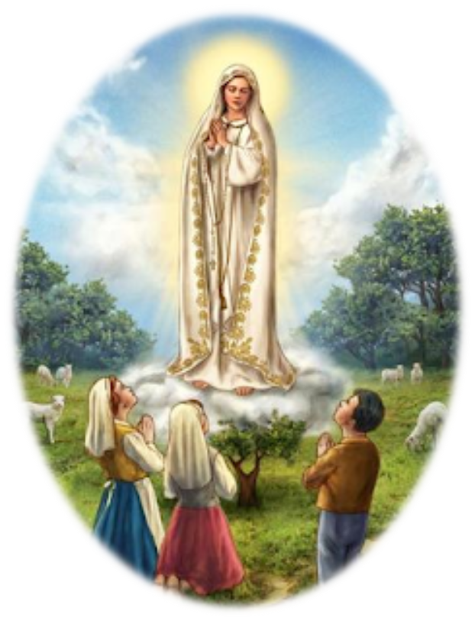

Slide 51
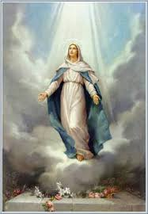
4th Glorious Mystery - The Assumption
May you be blessed, my daughter, by God most high, beyond all women on earth; and my the Lord God be blessed, the Creator of Heaven and earth. Judith 13:18
When Mary, the Blessed Mother of God, completed her life on earth, God did not allow her body to decay. Her body could have been an incorruptible one like some of the Saints, but God had bigger plans for her. Not only her soul, but also her body Assumed into Heaven at the end of her life. In a sense, Mary is a “first responder in our relationship with God. During this mystery we ask Mary’s intercession for all of our First Responders—police, firefighters, health care workers, teachers and clergy.

Slide 52
Our Father.
Who art in heaven,
Hallowed be Thy Name.
Thy kingdom come.
Thy will be done on earth as it is in heaven
Give us this day our daily bread and
Forgive us our trespasses as we forgive those who trespass against us.
Lead us not into temptation but deliver us from evil. Amen.

Slide 63
Glory Be to the Father
and to the Son
and to the Holy Spirit
as it was in the beginning, is now,
and ever shall be
world without end. Amen.

Slide 65
5th Glorious Mystery – Crowning of Mary
A great sign appeared in the sky, a woman clothed with the sun, with the moon under her feet, and on her head a crown of twelve stars. Revelations 12:1
When we meditate on this Glorious Mystery, what comes to mind most often is Mary’s humility. We can imagine Jesus placing a crown on her head as she humbly and graciously accepts it. Mary lovingly intercedes for us as we turn to her for her graces. She comforts us as a Mother should, and she always directs us toward her Son. As we grow closer to her, we grow closer to Jesus. During this mystery we once again consecrate ourselves to Mary as our Mother and our protector.

Slide 66
Our Father.
Who art in heaven,
Hallowed be Thy Name.
Thy kingdom come.
Thy will be done on earth as it is in heaven
Give us this day our daily bread and
Forgive us our trespasses as we forgive those who trespass against us.
Lead us not into temptation but deliver us from evil. Amen.

Slide 77
Glory Be to the Father
and to the Son
and to the Holy Spirit
as it was in the beginning, is now,
and ever shall be
world without end. Amen.

Slide 79
O God, whose only-begotten Son, by His life, death and resurrection, has purchased for us the rewards of eternal life; grant, we beseech Thee, that, meditating upon these mysteries of the Most Holy Rosary of the Blessed Virgin Mary, we may imitate what they contain and obtain what they promise, through Christ Our Lord. Amen.

Slide 80
Let Us Pray
O Mary, You shine continuously on our journey as a sign of salvation and hope. We entrust ourselves to you, Health of the Sick, who, at the foot of the cross, were united with Jesus’ suffering, and persevered in your faith.
“Protectress of all people”, you know our needs, and we know that you will provide, so that, as at Cana in Galilee, joy and celebration may return after this time of trial.
Help us, Mother of Divine Love, to conform ourselves to the will of the Father and to do what Jesus tells us. For he took upon himself our suffering, and burdened himself with our sorrowsto bring us, through the cross, to the joy of the Resurrection.
Amen.
We fly to your protection, O Holy Mother of God; Do not despise our petitions in our necessities, but deliver us always from every danger, O Glorious and Blessed Virgin.

Slide 81
“We fly to your protection, O Holy Mother of God”.
In the present tragic situation, when the whole world is prey to suffering and anxiety, we fly to you, Mother of God and our Mother, and seek refuge under your protection.
Virgin Mary, turn your merciful eyes towards us amid this coronavirus pandemic. Comfort those who are distraught and mourn their loved ones who have died, and at times are buried in a way that grieves them deeply. Be close to those who are concerned for their loved ones who are sick and who, in order to prevent the spread of the disease, cannot be close to them. Fill with hope those who are troubled by the uncertainty of the future and the consequences for the economy and employment.
Mother of God and our Mother, pray for us to God, the Father of mercies, that this great suffering may end and that hope and peace may dawn anew. Plead with your divine Son, as you did at Cana, so that the families of the sick and the victims be comforted, and their hearts be opened to confidence and trust.
Protect those doctors, nurses, health workers and volunteers who are on the frontline of this emergency, and are risking their lives to save others. Support their heroic effort and grant them strength, generosity and continued health.
Be close to those who assist the sick night and day, and to priests who, in their pastoral concern and fidelity to the Gospel, are trying to help and support everyone.

Slide 82
Blessed Virgin, illumine the minds of men and women engaged in scientific research, that they may find effective solutions to overcome this virus.
Support national leaders, that with wisdom, solicitude and generosity they may come to the aid of those lacking the basic necessities of life and may devise social and economic solutions inspired by farsightedness and solidarity.
Mary Most Holy, stir our consciences, so that the enormous funds invested in developing and stockpiling arms will instead be spent on promoting effective research on how to prevent similar tragedies from occurring in the future.
Beloved Mother, help us realize that we are all members of one great family and to recognize the bond that unites us, so that, in a spirit of fraternity and solidarity, we can help to alleviate countless situations of poverty and need. Make us strong in faith, persevering in service, constant in prayer.
Mary, Consolation of the afflicted, embrace all your children in distress and pray that God will stretch out his all-powerful hand and free us from this terrible pandemic, so that life can serenely resume its normal course.
To you, who shine on our journey as a sign of salvation and hope, do we entrust ourselves,
O Clement, O Loving, O Sweet Virgin Mary. Amen.

Slide 83
